Slide 1

Data Instruments
for
Software-Defined Organizations
Ben Koo
May 22, 2021
Moore’s Law
Notes:
https://www.aliexpress.com/item/33004770035.html

Slide 2
Context: Design Challenges and Learning
Why:
Dedicated Data Instruments to empower your HDX Challenges
What:
Minimalistic technical barrier to realize your Designs
How:
More supportive documents and videos linked on PKC

Slide 3






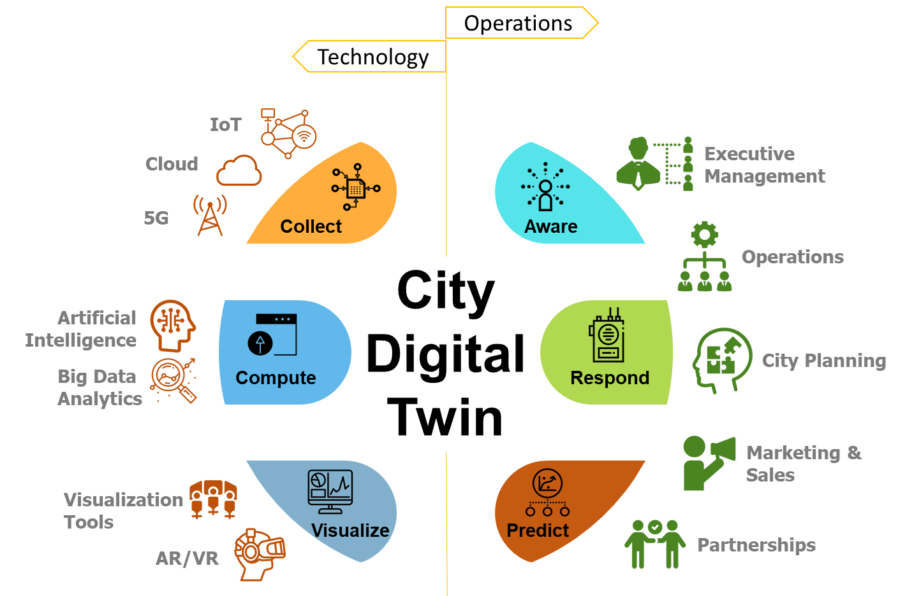
Goal: Unified Data Presentation/Collection
Pages
in Web Browsers
A Web3D Demo
Files
Computational
Services
Internet of Things
Demo: ChaosToPerfection
Demo: VIZZIO.AI
Huawei Digital Twin Vision

Slide 4
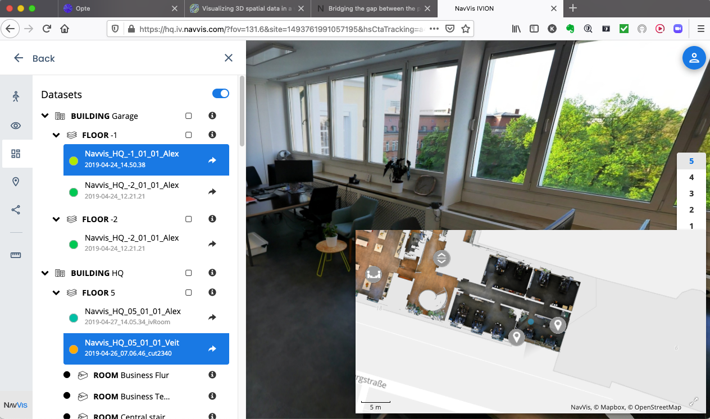
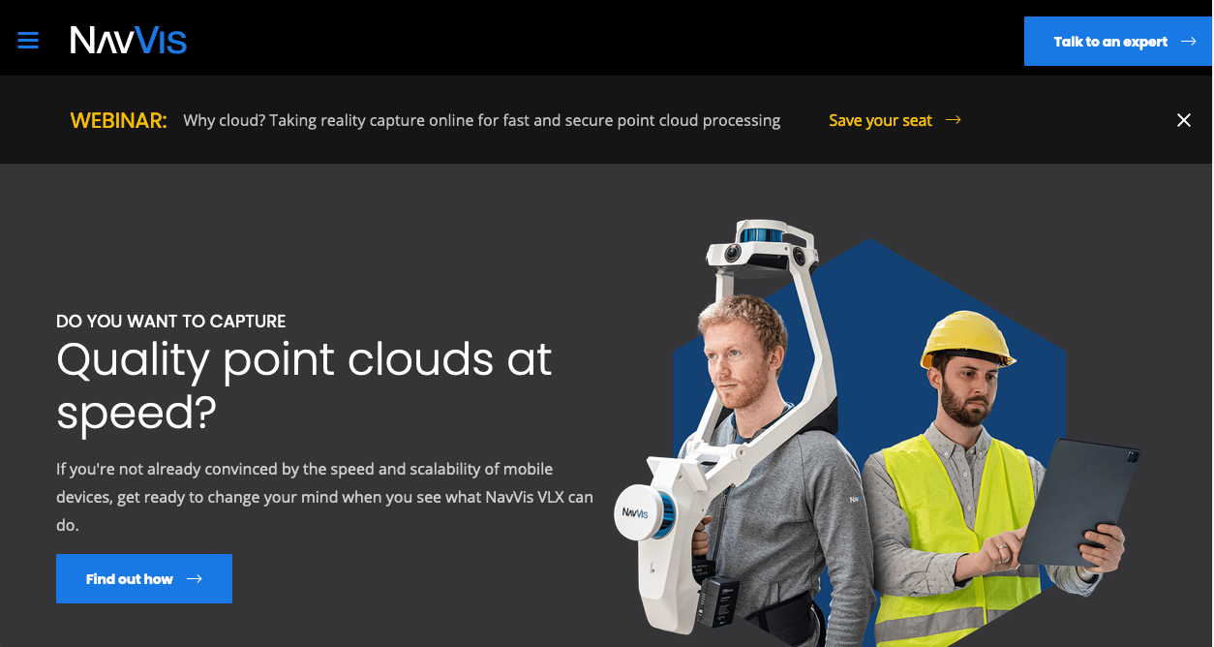
A Digital Twin Demo in Browsers

Slide 5




Types of Data Asset
Asset Class | Transactions | Asset Container
Page | Content Presentation/Edit | Page Database
File | Changing File Structures | GitHub
Service | Execute Programs | DockerHub

Slide 6
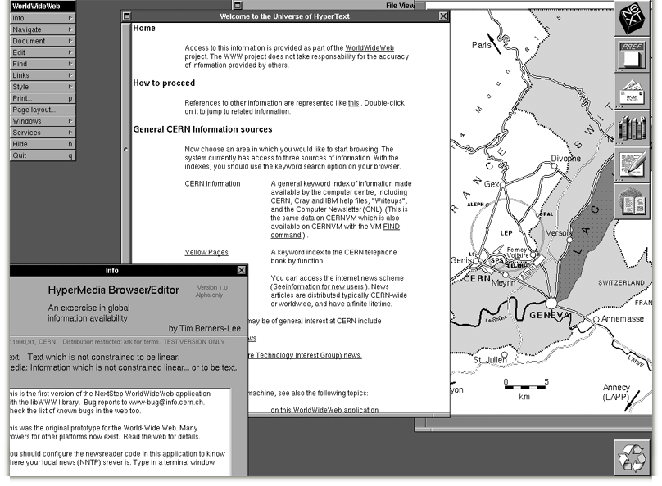
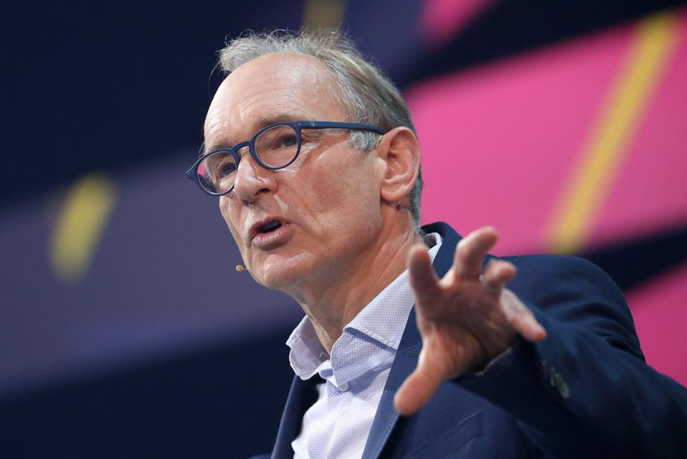
Web Pages: a Unifying Data Presentation/Editable Format
Berners-Lee called his vision for the web “utopian.”
He created the idea of Universal Resource Locator (URL).
https://www.opte.org

Slide 7
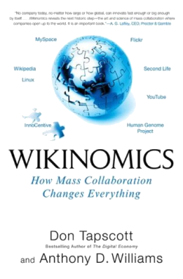
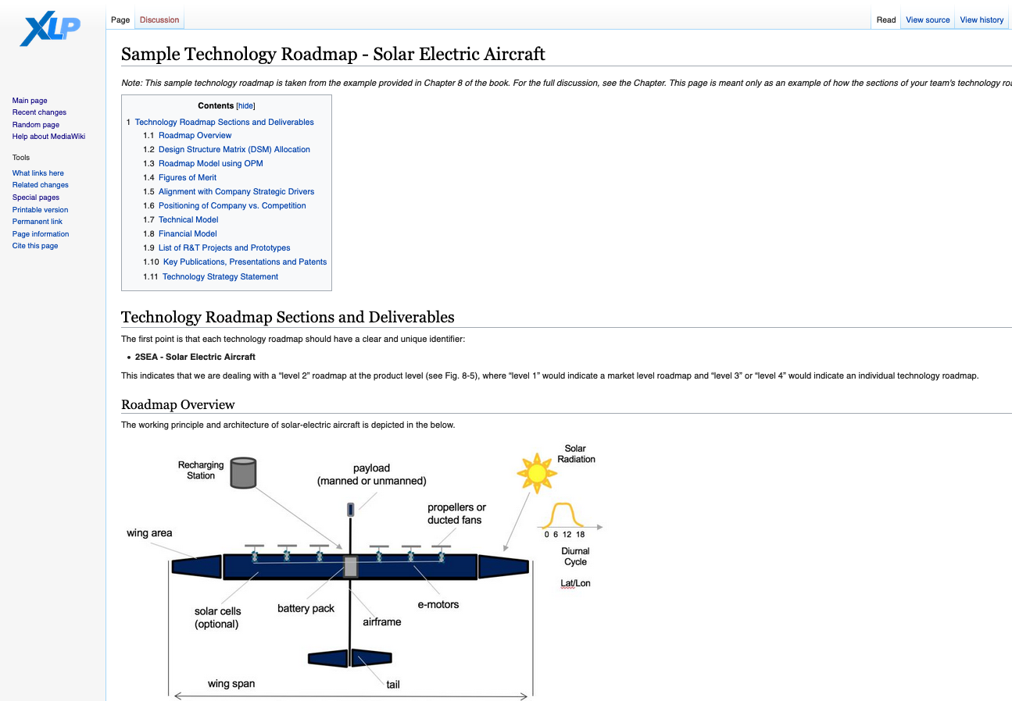
Wiki: Quick Data Publishing enabled Mass Collaboration
https://xlp.mit.edu

Slide 8
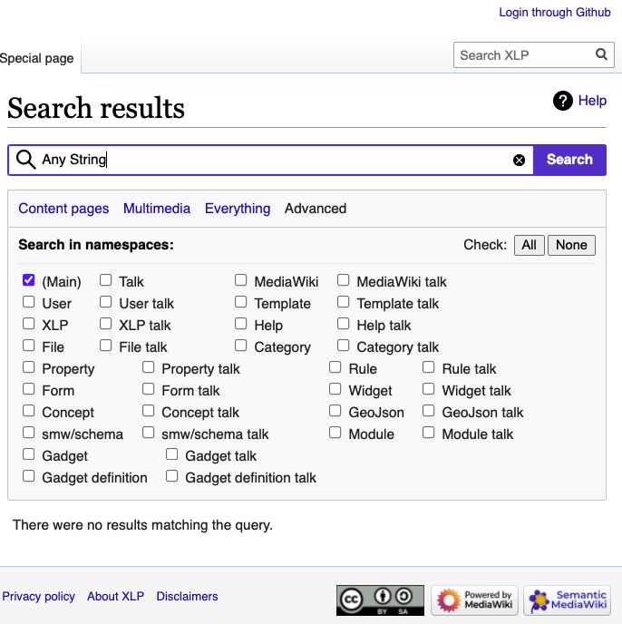
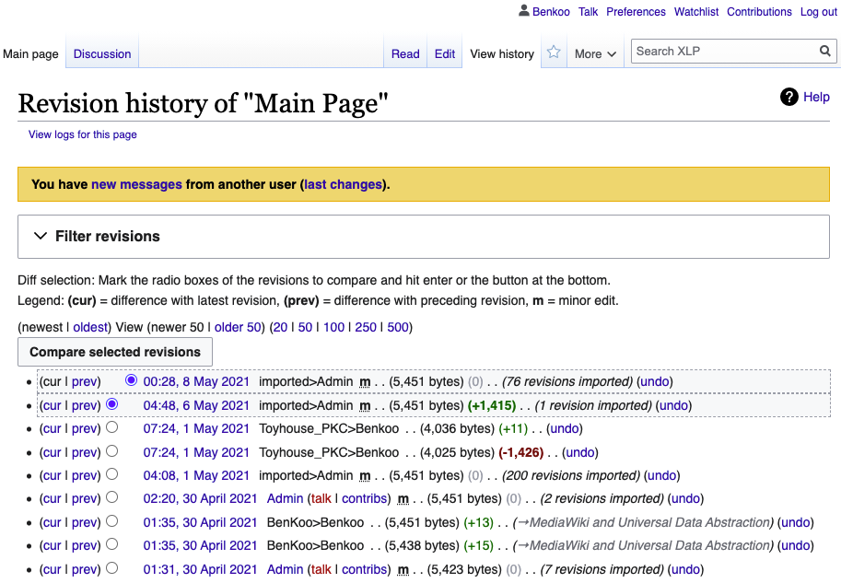
Two Fundamental Properties of Assets: Namespace and Time
https://xlp.mit.edu

Slide 9
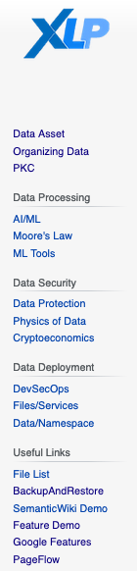
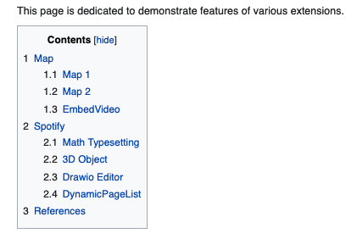
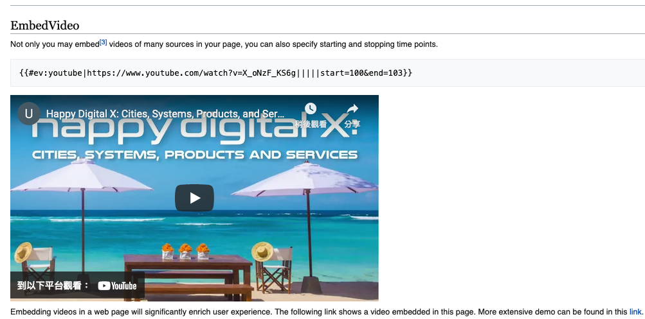
Embedding Multimedia Data in a Page
https://xlp.pub/

Slide 10
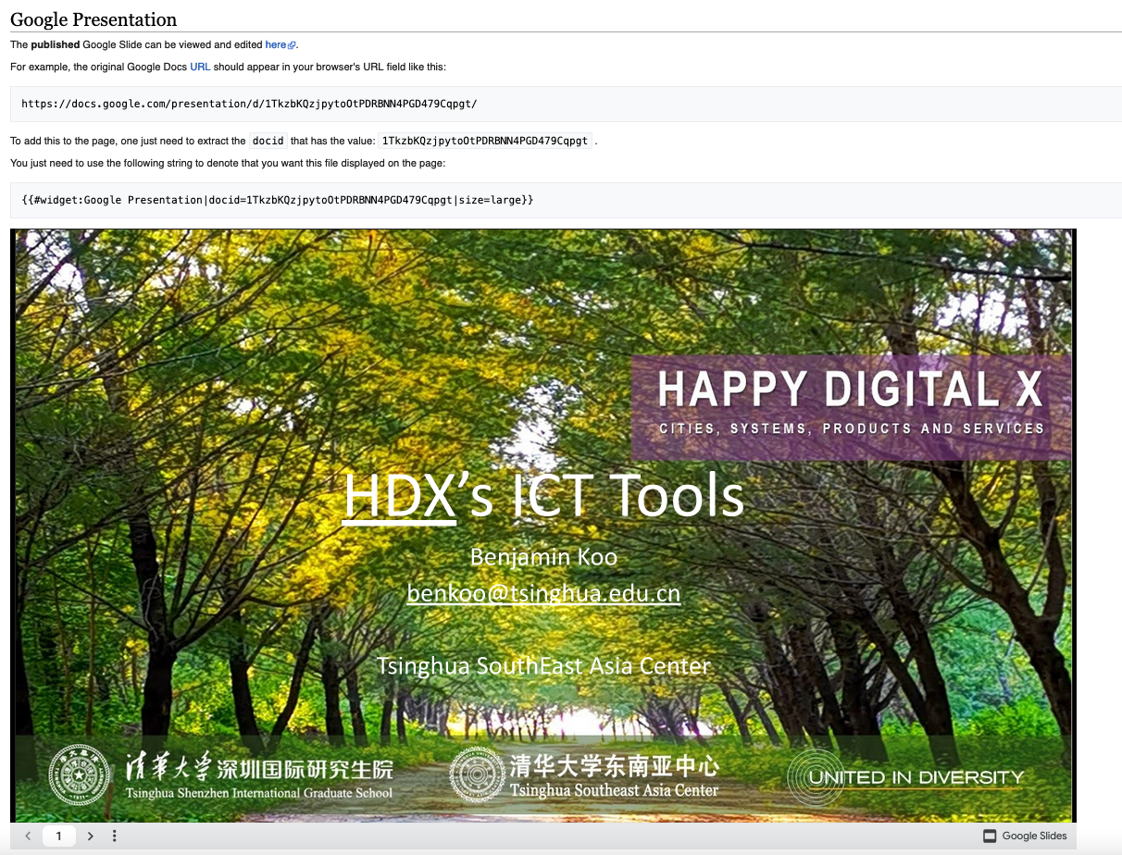
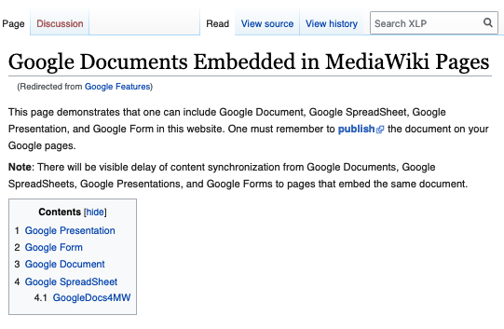
Embedding Multimedia Data in a Page
https://xlp.pub/

Slide 11
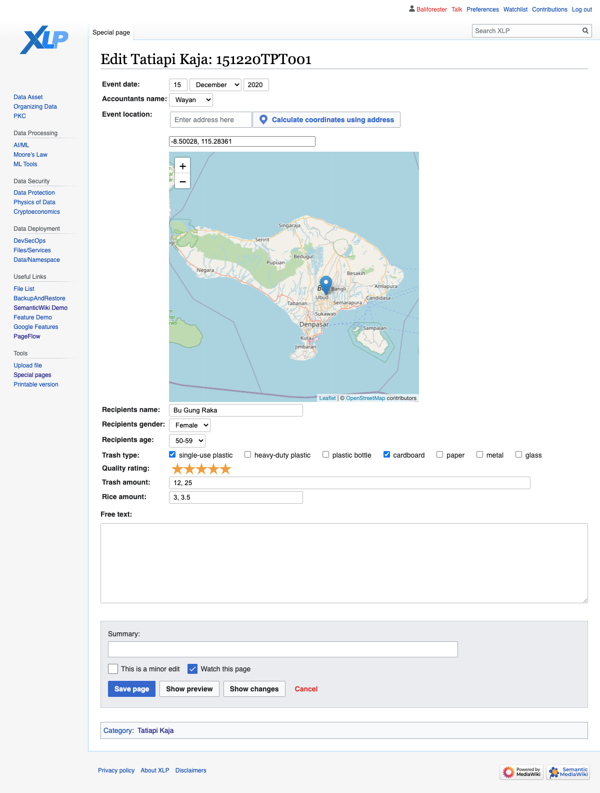
Semantic MediaWiki: Automatically Creates Forms
Map inputs
Multiple select
Dropdown lists
Ratings
Defined Categories
Defined Properties
Default autofill
https://xlp.pub/index.php/Special:FormEdit/PE_Collector_Submission_Form/Plastic_Exchange_Submission_Form_100230

Slide 12


Git as a Unifying Data Abstraction
Creator of Linux and Git: Linus Torvalds

Slide 13
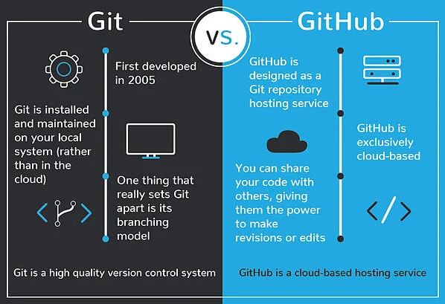

Git and Github.com
Image Source: https://blog.devmountain.com/git-vs-github-whats-the-difference/

Slide 14
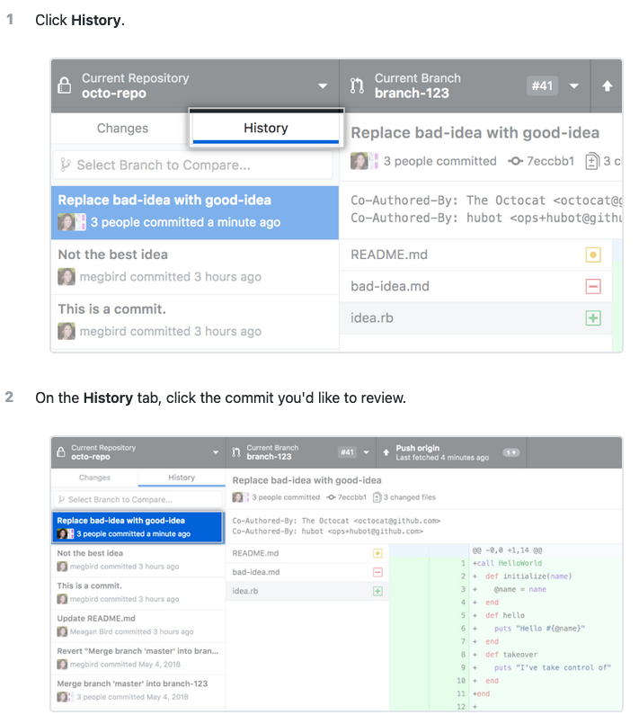
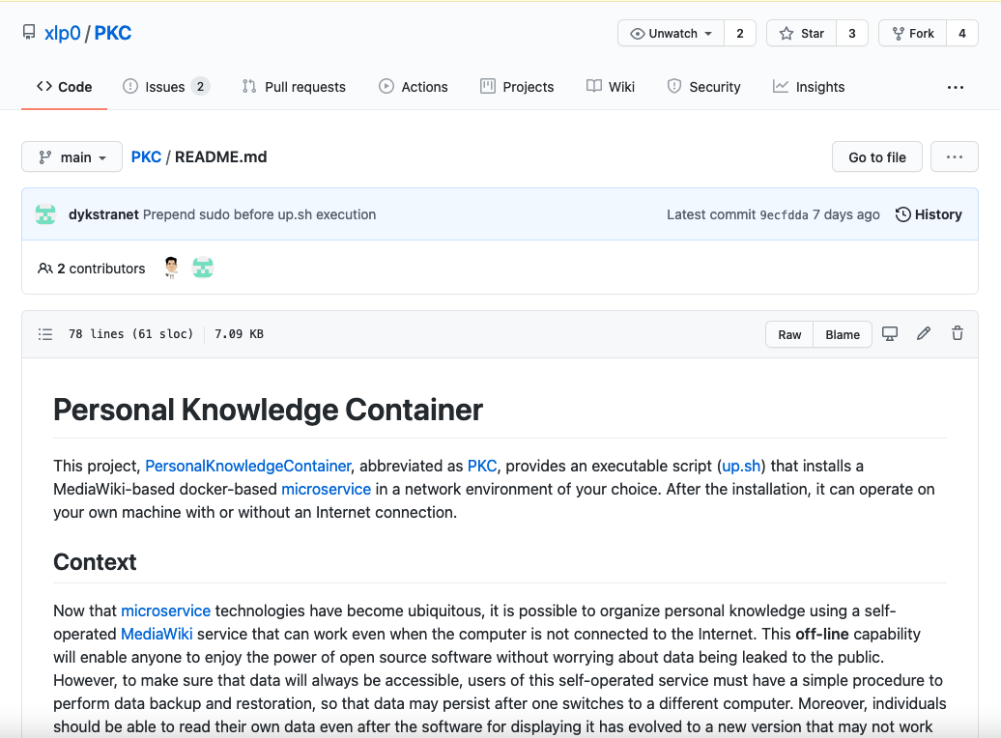
Github: A File Synchronization Service
https://docs.github.com/en/desktop/contributing-and-collaborating-using-github-desktop/making-changes-in-a-branch/viewing-the-branch-history
https://www.github.com/

Slide 15
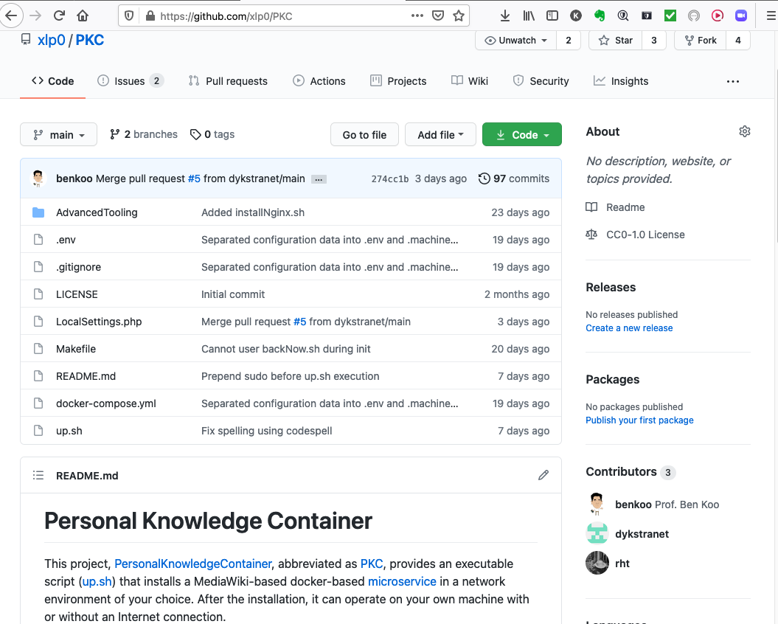
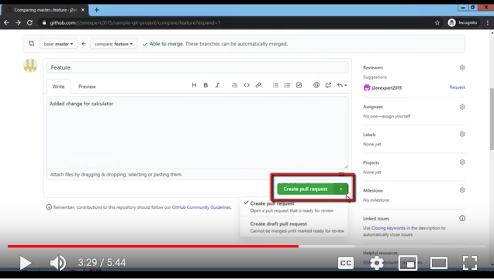
Github Pull Request (PR)
Pull Request is a polite way to engage
Anyone around the world to share their changes with you.
https://www.youtube.com/watch?v=npnfDwmHKhY
https://www.github.com/

Slide 16
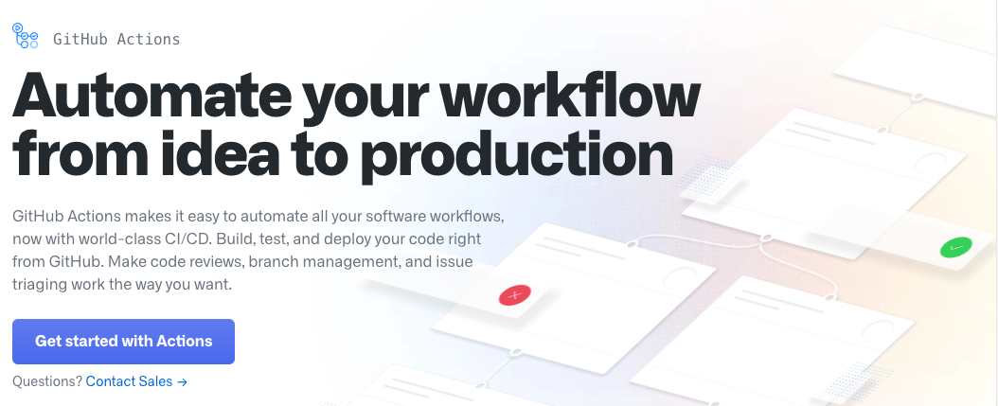
Github Action
Github Action allows you to trigger automated events once changes are commited to a GitHub Project.
https://github.com/features/actions

Slide 17
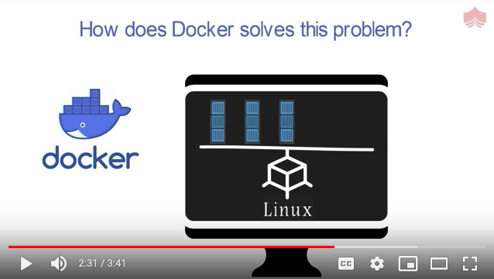
Microservice: Dockerized Service Containers
https://www.docker.io/

Slide 18
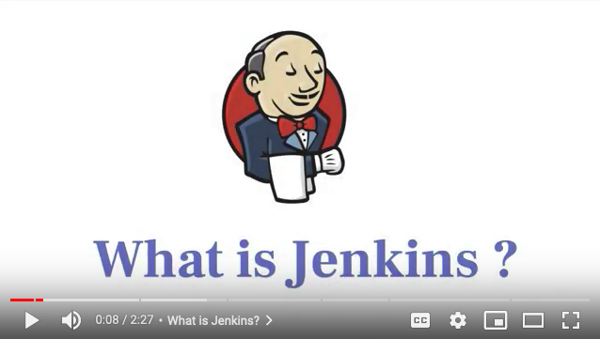
Jenkins: Continuous Integration & Deployment
Video Source: https://www.youtube.com/watch?v=GpuozJ-GEpE

Slide 19
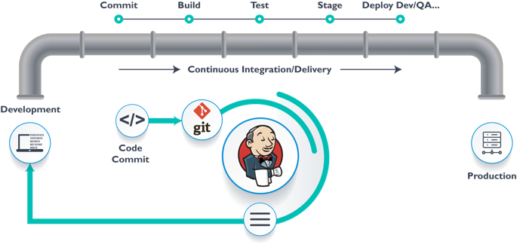
DevOps, Data Ops, AI/ML Ops, GitOps

Slide 20

Tools of DevOps
Image courtesy: PETSEBAN on NearCoding

Slide 21
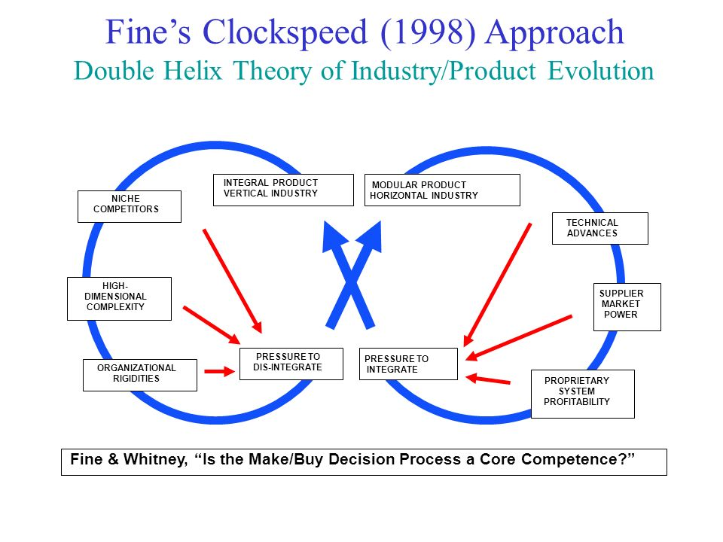

DevOps, CI/CD delivers faster Clockspeeds

Slide 22
GitOps: Git as the Single Source of Truth
Paradigm
Change
Normal Science
Kuhn’s Cycle
Model Revolution
Model
Drift
Model Crisis

Slide 23

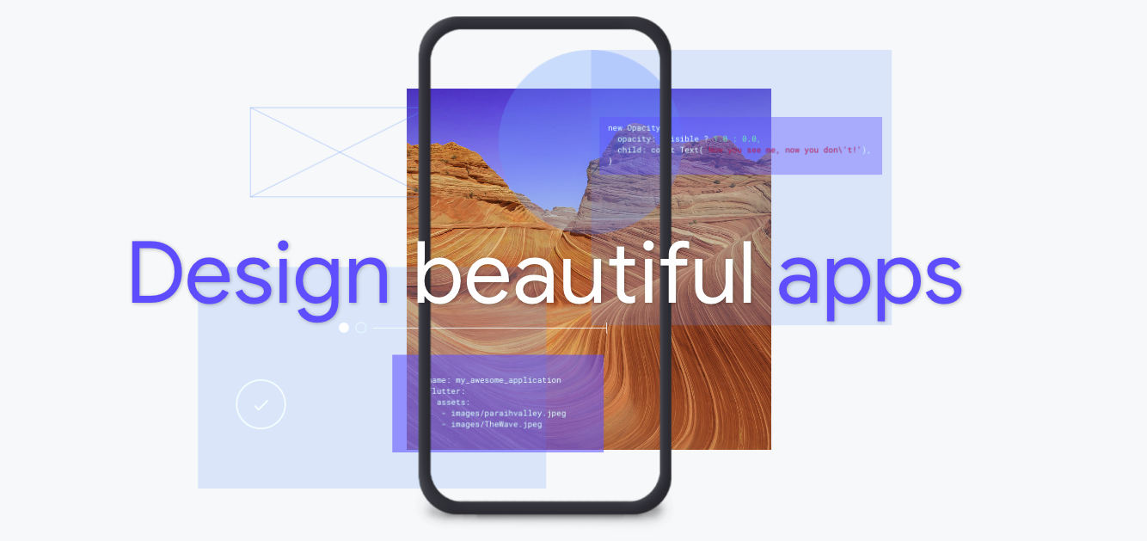
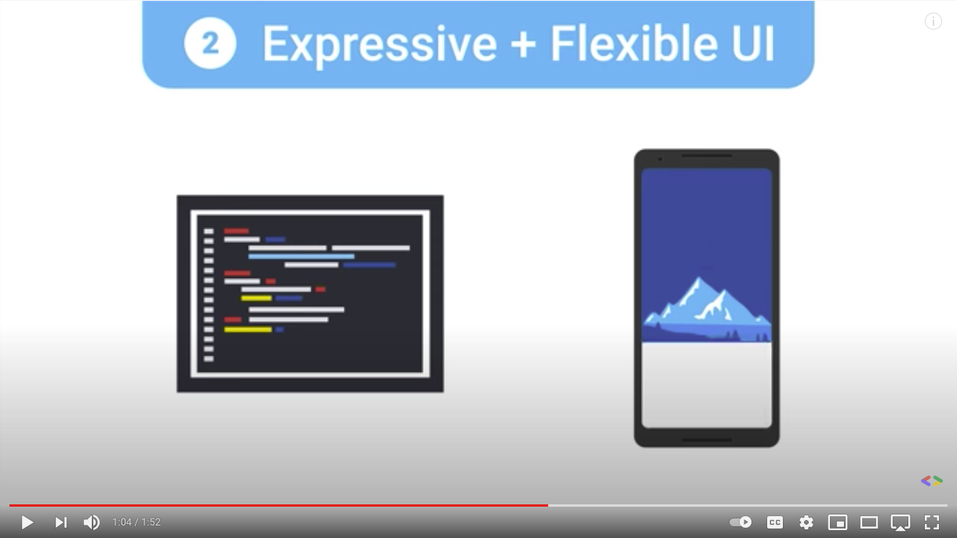
A Universal User-Interface Development Platform
Video Source: https://www.youtube.com/watch?v=fq4N0hgOWzU

Slide 24
The Web (hyperlinked) Data is the simplest possible Data Structure to be Universally Applicable!

Slide 25
Summary
Centralize your teamwork on https://xlp.pub
Catch the flag: create a self-intro page
Utilize Git and GitHub for team workflow
Use Semantic MediaWiki to build Prototypes
We can set up your instances of PKC

